Slide 1
Drawings as a window into shared meaning
Molly Lewis
Lupyan Lab Meeting, 12 October 2017

Slide 2
Foundational assumptions about meaning
Shared by members within same community
“dog” in language X prototypically means dalmation
Social psychologists talk about “shared social reality”
Varies across communities
In language Y, “dog” prototypically means poodle
Converges through interaction (Brennan & Clark, 1996)
But lots we don’t know:
How much variability is there across communities?
What kinds of meanings vary most (e.g., frequent vs. infrequent, abstract vs. concrete)?
What are the processes by which communities converge on meaning?
What predicts variability across cultures?

Slide 3
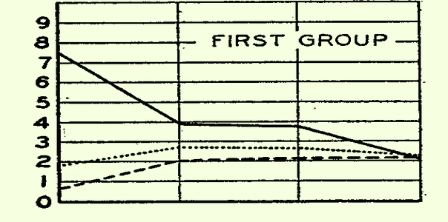
Convergence on shared reality through “conformity”
Sherif’s autokinetic experiment (1935)
Asch’s line experiment (1951)
Distance (inches)
Individiually
Group (t1)
Group (t2)
Notes:
Scherif: He used the autokinetic effect – this is where a small spot of light (projected onto a screen) in a dark room will appear to move, even though it is still (i.e. it is a visual illusion).
shows the median distance judgement (in inches) for three different subjects. The x-axis plots subjects performance on the task when completed individually, and then three subsequent periods in which the task was completed as a group (of 3 subjects).
It was discovered that when participants were individually tested their estimates on how far the light moved varied considerably (e.g. from 20cm to 80cm).
The participants were then tested in groups of three. Sherif manipulated the composition of the group by putting together two people whose estimate of the light movement when alone was very similar, and one person whose estimate was very different. Each person in the group had to say aloud how far they thought the light had moved.
Asch video: https://www.youtube.com/watch?time_continue=41&v=iRh5qy09nNw
Asch: about one third (32%) conformed

Slide 4
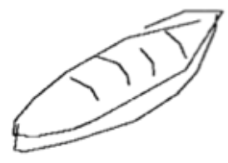
Drawings as a window into meaning
Cognitive representations of meaning difficult to infer from language
v
v
->
“bread” -> ?
…But may be easier from drawings.

Slide 5
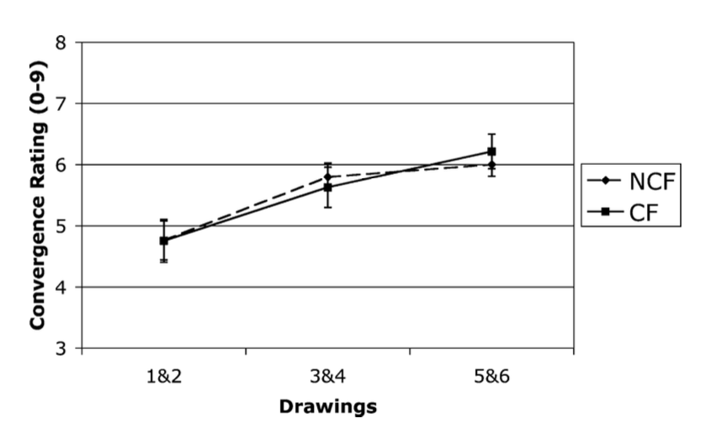
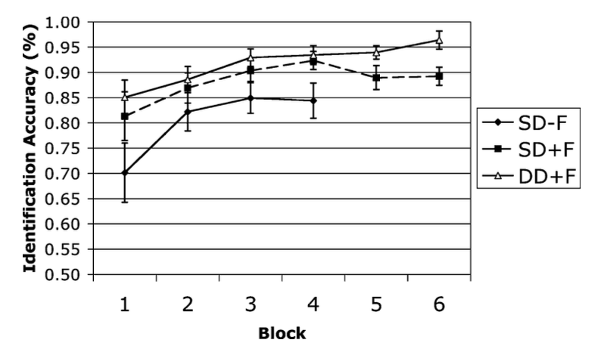
Evidence for conformity in reference (Garrod, et al., 2007)
Pictionary game, manipulating the amount of feedback guesser gives to drawer
How do drawings and accuracy change across repeated interactions?
Feedback
Feedback
No Feedback
Notes:
Convergence, but not as much acuracy when no feedback (presumably because less convergence)

Slide 6
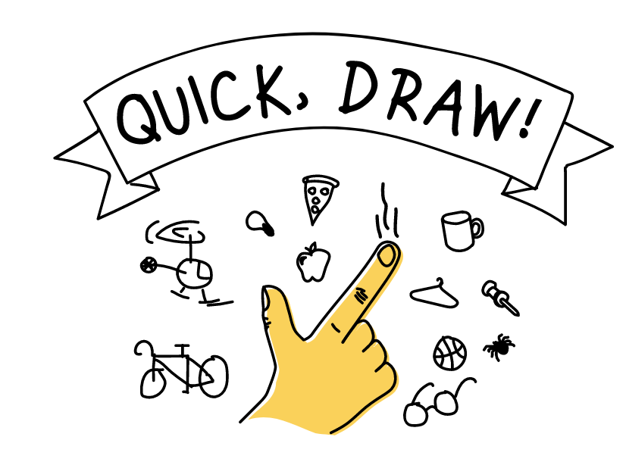
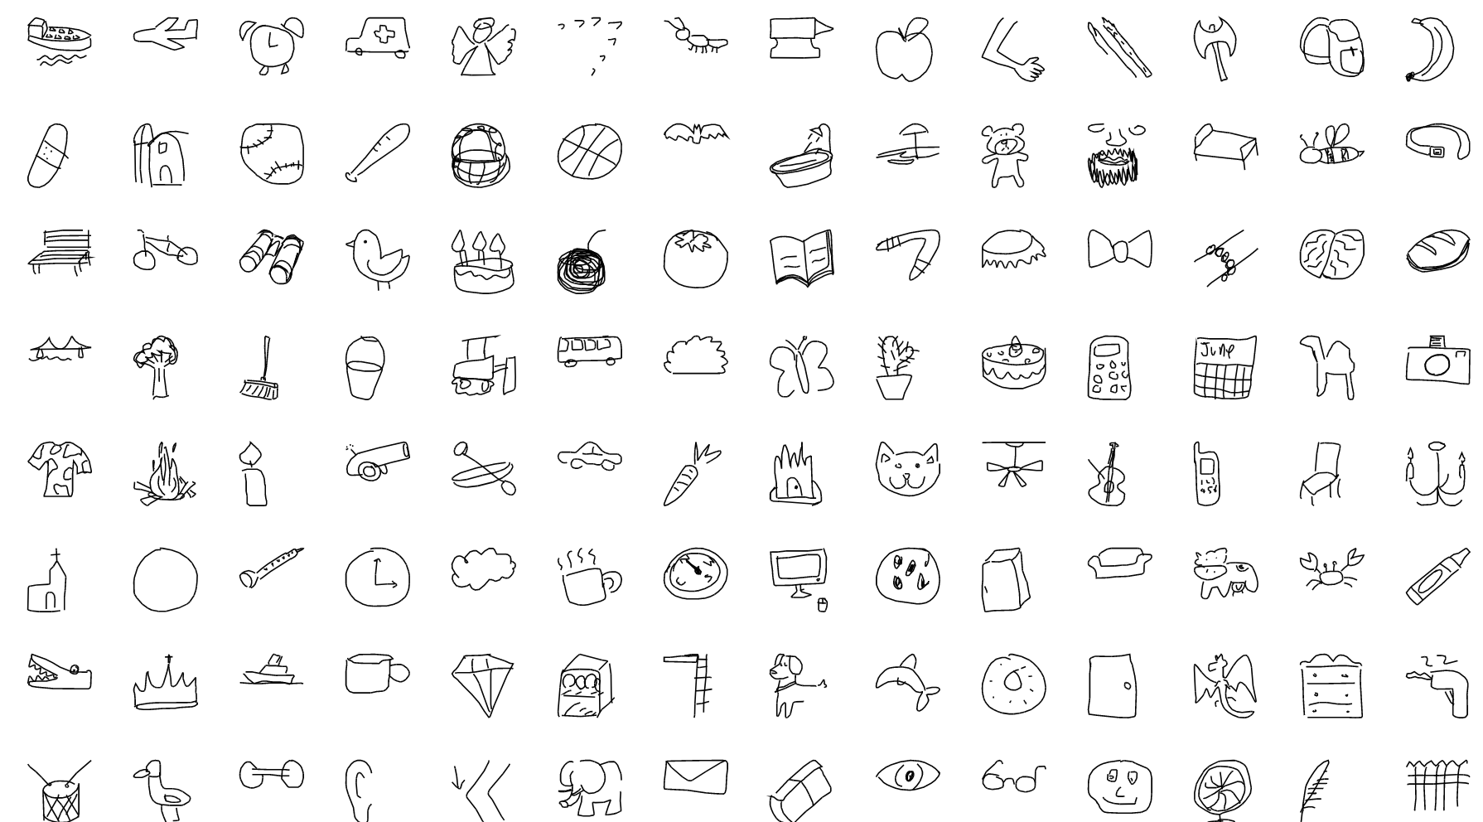
15M participants produced over 50M drawings, across 345 categories [LINK]
Notes:
Link: https://quickdraw.withgoogle.com/

Slide 7
Analyses
Can we measure within-community convergence?
Two measures of “convergence” (i.e. image similarity)
(1) Hausdorff Distance - image similarity as the minimum Euclidean distance between two sets of points (Huttenlocher, Klanderman, & Rucklidge, 1993)
(2) Internal weights (layer FC2) for drawing from a neural net model trained on ImageNet, with similarity corresponding to the cosine distance on weights between pairs of images.

Slide 8
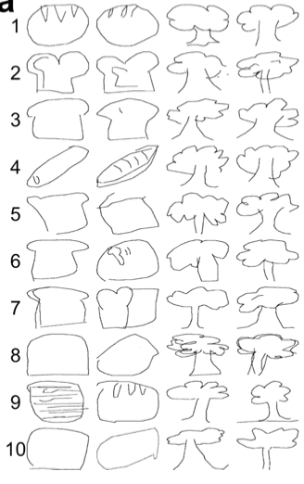
Validating similarity measures with human judgements
1500 image pairs from two categories (“bread” and “tree”) drawn by participants across 72 countries
Selected 20 pairs from each decile of similarity (per item)
Asked participants to rate similarity (1-7 Likert scale)
Each participant (N =100) rated 50 pairs from each category

Slide 9
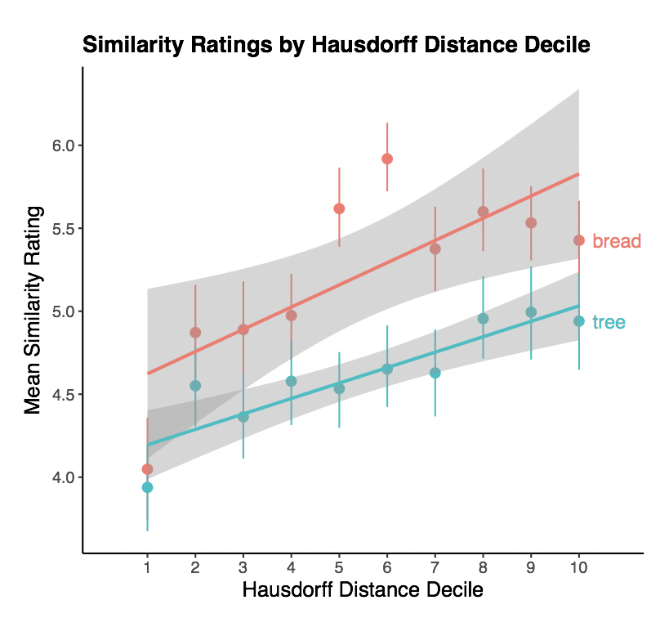
Human similarity results
Correlated with both
Haussdorf Distance (r = .29)
and cosine similarity (r = .2)
N = 100

Slide 10
Can we predict variability in similarity across country pairs?
Notes:
Item prototypes by country: bread: smallest average pairwise distance to other drawings from the same country.

Slide 11
“cultural” predictors
ASJP Distance
WALS Euclidean Distance
Event distance
Trade
Physical distance

Slide 12
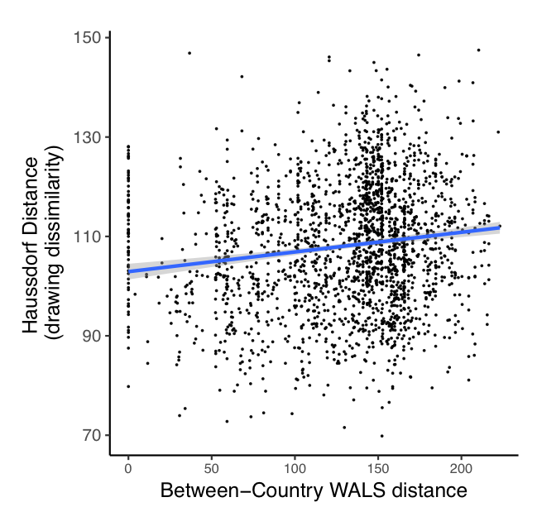
Notes:
bread

Slide 13
Future directions
First N strokes
* scale up with more items- variability in concepts ~ variability in heterogenity- what are the best predictors using a bunch of different measures (including d-space)-> what are the properties of items that vary more - frequent, less frequent?- is there a way to think about which are more veridical? E.e. top N images in google images search, searching by country[conventionality]* two broad framinings: about shared meaning, and representation for as proxy; about how representations change over timeSketch* graphical complexity-> CONTENT - predicting variability using similairity measures - what's the difference between the two similarity measurse? [NN vs. haussdorf] - use different layers on neural net - earlier features - try using drawing-trained NN - predicting hetergenity in picture and heterogenity in content - which items vary more, and what are their properties? - which itme sare more veridical E.e. top N images in google images search, searching by country [conventionality] - more measures of cultural variability (d-space) - really cool human data one could collect would be to have semantic segmentation/annotation (like the COCO dataset, but for parts of objects in sketches). Like, tagging marks as being of one part, and labeling it accordingly. Could be used to train a semantic parser for this domain, which would be really neat. But nearer at hand, it could address your question about whether people "subset" different parts of objects in different places... presumably the distribution of % ink per part might be more similar among sketchers from the same place, and this might predict how people categorize them. -> DYNAMICS: One could imagine a recognition task where the sketches are "degraded" to varying degrees by removing the last k strokes, and that the number of strokes required to recognize the object is similar between sketches from the same place, but different across places. Assumption being that the priority of different subparts is similar where people share the same visual conventions.

